Slide 1
The Internet Transport Protocols

Slide 2
Introduction
The Internet has two main protocols in the transport layer, a connectionless protocol and a connection-oriented one. The protocols complement each other.
The connectionless protocol is UDP: It does almost nothing beyond sending packets between applications, letting applications build their own protocols on top as needed.
The connection-oriented protocol is TCP: It does almost everything. It makes connections and adds reliability with retransmissions, along with flow control and congestion control, all on behalf of the applications that use it.

Slide 3
Introduction to UDP
The Internet protocol suite supports a connectionless transport protocol called UDP (User Datagram Protocol).
UDP provides a way for applications to send encapsulated IP datagrams without having to establish a connection.
UDP transmits segments consisting of an 8-byte header followed by the payload.

Slide 4
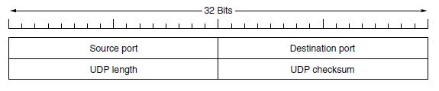
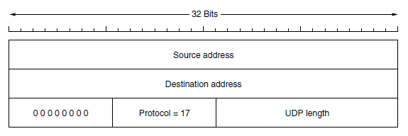
The two ports serve to identify the endpoints within the source and destination machines.
When a UDP packet arrives, its payload is handed to the process attached to the destination port.
Figure: The UDP header
Figure: The IPv4 pseudo header included in the UDP checksum.

Slide 5
Remote Procedure Call
Sending a message to a remote host and getting a reply back is a lot like making a function call in a programming language. In both cases, you start with one or more parameters and you get back a result. This observation has led people to try to arrange request-reply interactions on networks to be cast in the form of procedure calls.
When a process on machine 1 calls a procedure on machine 2, the calling process on 1 is suspended and execution of the called procedure takes place on 2. Information can be transported from the caller to the callee in the parameters and can come back in the procedure result.
No message passing is visible to the application programmer. This technique is known as RPC (Remote Procedure Call) and has become the basis for many networking applications.
The idea behind RPC is to make a remote procedure call look as much as possible like a local one.
In the simplest form, to call a remote procedure, the client program must be bound with a small library procedure, called the client stub, that represents the server procedure in the client’s address space.
Similarly, the server is bound with a procedure called the server stub. These procedures hide the fact that the procedure call from the client to the server is not local.
The actual steps in making an RPC are shown in below Fig.

Slide 6
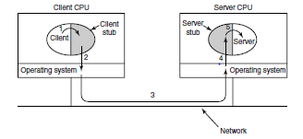
Step 1 is the client calling the client stub. This call is a local procedure call, with the parameters pushed onto the stack in the normal way.
Step 2 is the client stub packing the parameters into a message and making a system call to send the message. Packing the parameters is called marshaling.
Step 3 is the operating system sending the message from the client machine to the server machine.
Step 4 is the operating system passing the incoming packet to the server stub.
Step 5 is the server stub calling the server procedure with the unmarshaled parameters. The reply traces the same path in the other direction.

Slide 7
RTP (Real-time Transport Protocol)
Client-server RPC is one area in which UDP is widely used.
Another one is for real-time multimedia applications. In particular, as Internet radio, Internet telephony, music-on-demand, videoconferencing, video-on-demand, and other multimedia applications became more commonplace, people have discovered that each application was reinventing more or less the same real-time transport protocol.
There are two aspects of real-time transport. The first is the RTP protocol for transporting audio and video data in packets.
The second is the processing that takes place, mostly at the receiver, to play out the audio and video at the right time.

Slide 8
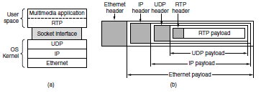
RTP (Contd.,)
These functions fit into the protocol stack as shown in Fig.
Figure:(a) The position of RTP in the protocol stack. (b) Packet nesting.

Slide 9
TCP (Transmission Control Protocol)
TCP was specifically designed to provide a reliable end-to-end byte stream over an unreliable internetwork.
An internetwork differs from a single network because different parts may have wildly different topologies, bandwidths, delays, packet sizes, and other parameters.
TCP was designed to dynamically adapt to properties of the internetwork and to be robust in the face of many kinds of failures.
Each machine supporting TCP has a TCP transport entity, either a library procedure, a user process, or most commonly part of the kernel.
In all cases, it manages TCP streams and interfaces to the IP layer.
A TCP entity accepts user data streams from local processes, breaks them up into pieces not exceeding 64 KB and sends each piece as a separate IP datagram.
When datagrams containing TCP data arrive at a machine, they are given to the TCP entity, which reconstructs the original byte streams.
The IP layer gives no guarantee that datagrams will be delivered properly, nor any indication of how fast datagrams may be sent. It is up to TCP to send datagrams fast enough to make use of the capacity but not cause congestion, and to time out and retransmit any datagrams that are not delivered.
Datagrams that do arrive may well do so in the wrong order; it is also up to TCP to reassemble them into messages in the proper sequence.

Slide 10
The TCP Service Model
TCP service is obtained by both the sender and the receiver creating end points, called sockets, Each socket has a socket number (address) consisting of the IP address of the host and a 16-bit number local to that host, called a port.
A port is the TCP name for a TSAP. For TCP service to be obtained, a connection must be explicitly established between a socket on one machine and a socket on another machine.
Port numbers 1024 are reserved for standard services that can usually only be started by privileged users. They are called well-known ports.
For example, any process wishing to remotely retrieve mail from a host can connect to the destination host’s port 143 to contact its IMAP daemon.
The list of well-known ports is given at www.iana.org. Over 700 have been assigned. A few of the better-known ones are listed in Fig.

Slide 11
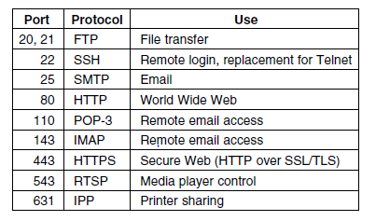
The TCP Service Model(Contd.,)
Figure: Some assigned ports.
Other ports from 1024 through 49151 can be registered with IANA for use by unprivileged users, but applications can and do choose their own ports.

Slide 12
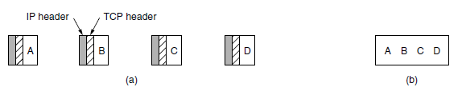
The TCP Service Model(Contd.,)
All TCP connections are full duplex and point-to-point. Full duplex means that traffic can go in both directions at the same time. Point-to-point means that each connection has exactly two end points.
TCP does not support multicasting or broadcasting.
A TCP connection is a byte stream, not a message stream. Message boundaries are not preserved end to end.
For example, if the sending process does four 512-byte writes to a TCP stream, these data may be delivered to the receiving process as four 512-byte chunks, two 1024-byte chunks, one 2048-byte chunk (see Fig. (a) Four 512-byte segments sent as separate IP datagrams. (b) The2048 bytes of data delivered to the application in a single READ call.).

Slide 13
The TCP Segment Header
Figure shows the layout of a TCP segment.
Every segment begins with a fixed-format, 20-byte header. The fixed header may be followed by header options.
After the options, if any, up to 65,535 − 20 − 20 = 65,495 data bytes may follow, where the first 20 refer to the IP header and the second to the TCP header.
Segments without any data are legal and are commonly used for acknowledgements and control messages.

Slide 14
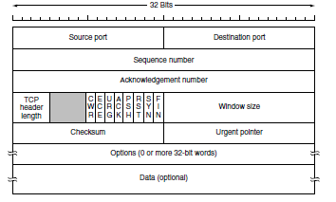
Figure: The TCP header.

